Slide 1
MaCHINE LEARNING

Slide 2
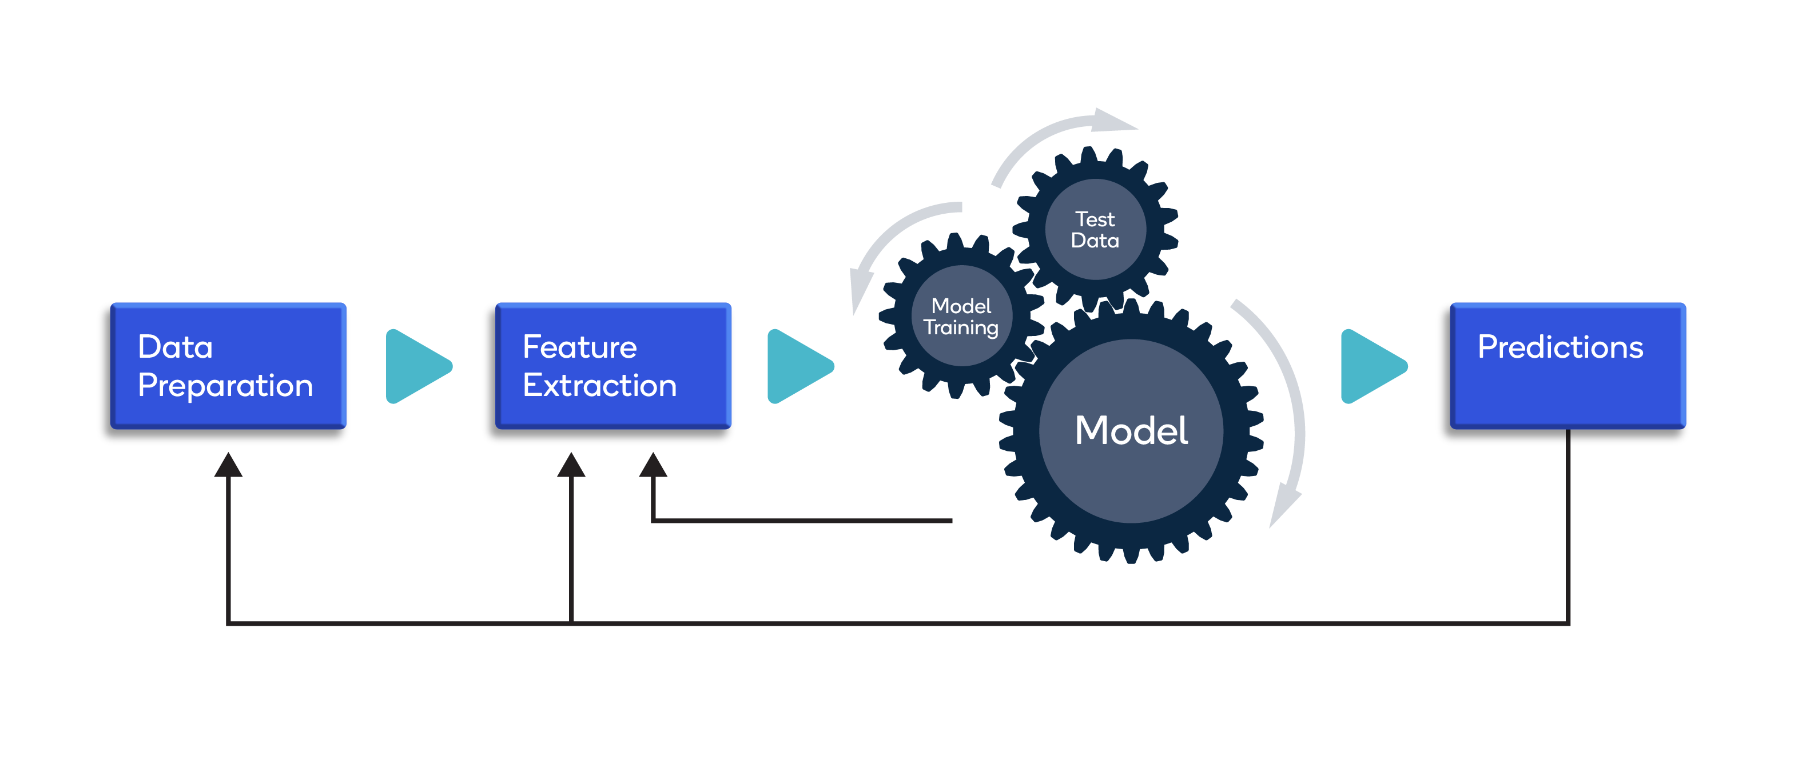

Slide 3
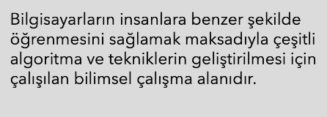
Machine learning
Makine Öğrenmesi

Slide 4
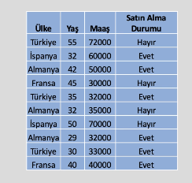
Machine learning

Slide 5
Machine learning
Türk, 32 yaş, 30 bin gelir?
Fransız, 46 yaş, 32 bin gelir?
Türkiye’ye en benzeyen ülke?

Slide 6
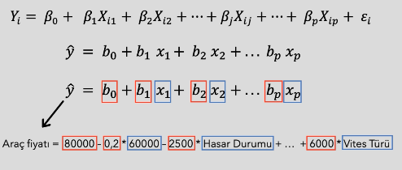
Machine learning
Arabam Ne kadar Eder?

Slide 7
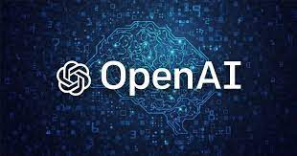


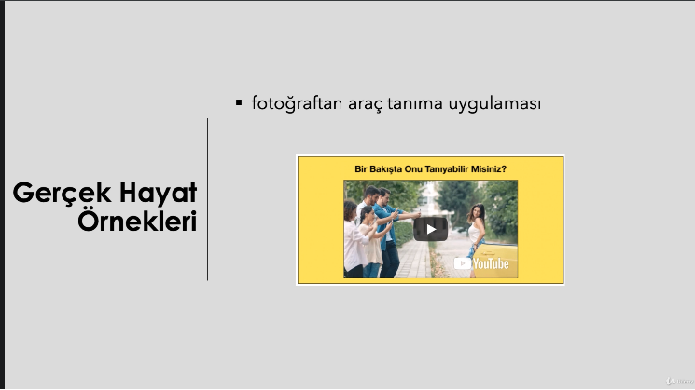
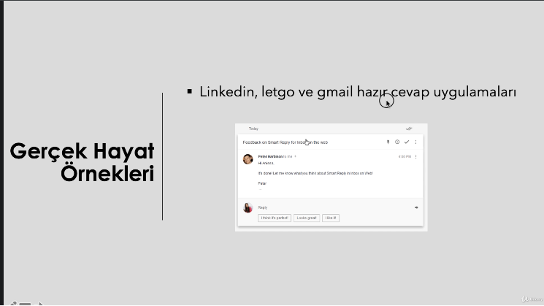
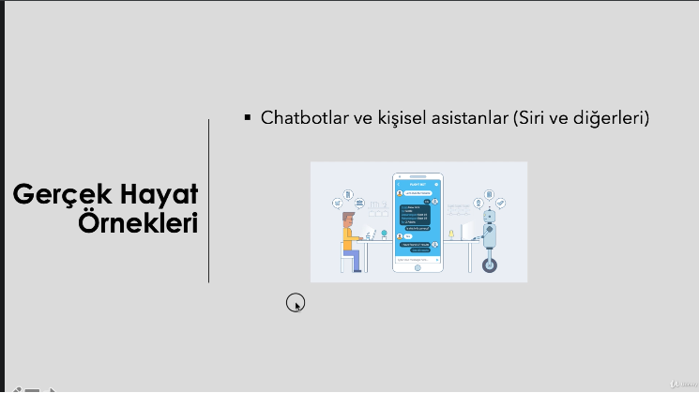
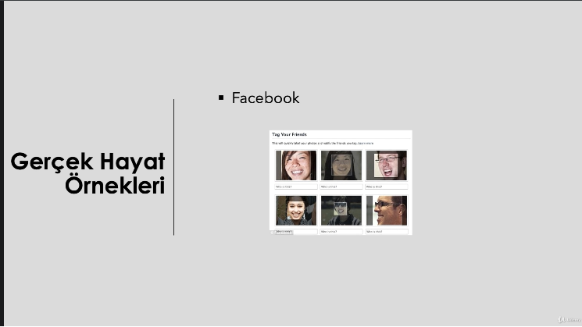
Machine learning
ML Uygulamaları

Slide 8
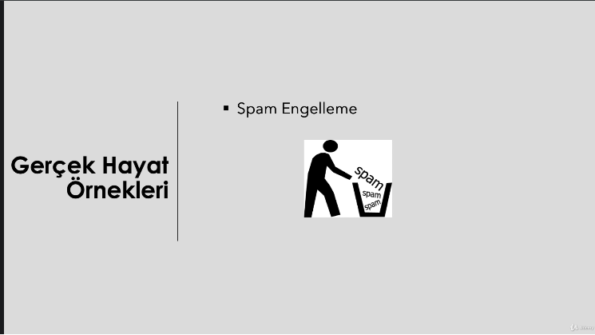
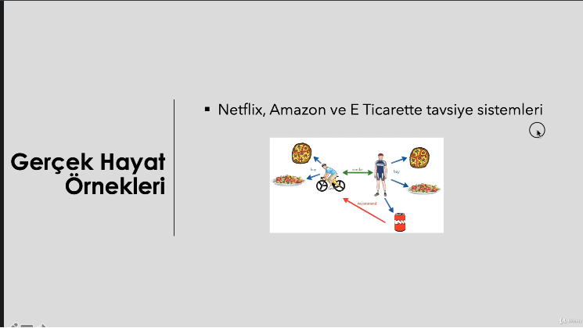
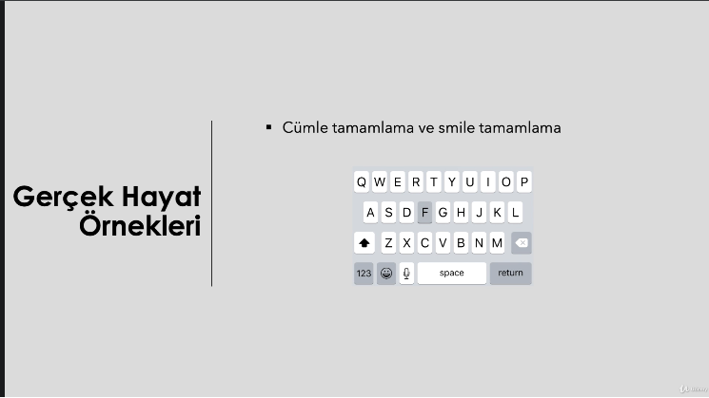
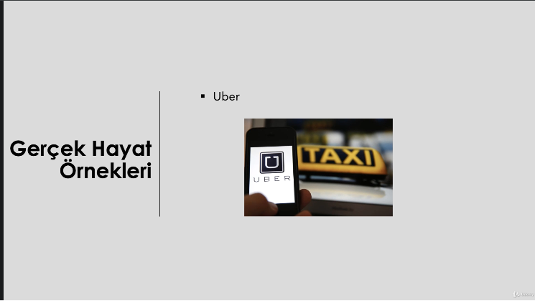

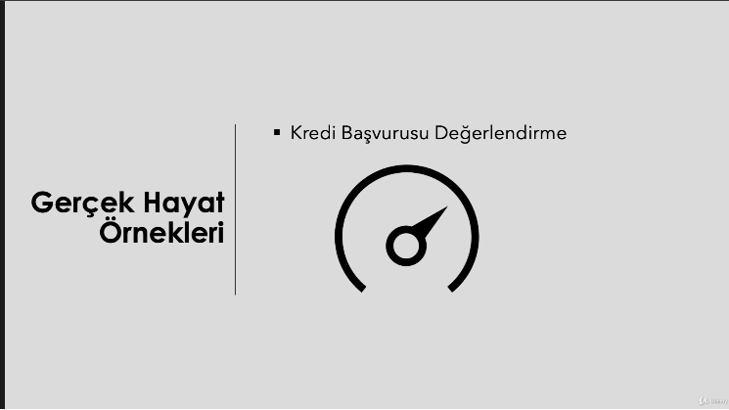
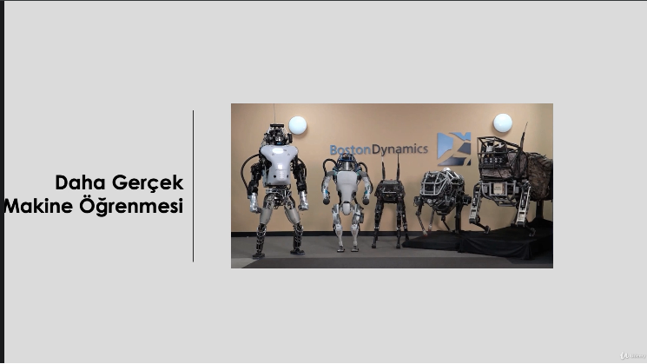
Machine learning
ML Uygulamaları

Slide 9
Machine learning
Terminoloji

Slide 10
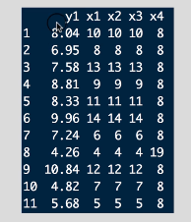
Machine learning
Bağımlı ve Bağımsız Değişken

Slide 11
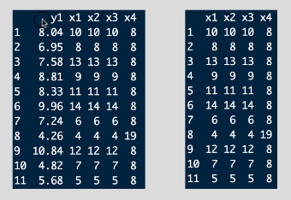
Machine learning
Gözetimli (Supervised) ve Gözetimsiz (Unsupervised) Learnig

Slide 12
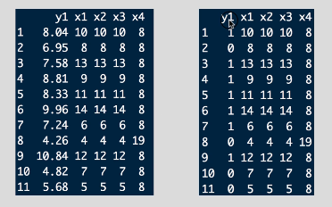
Machine learning
Regresyon (Regression) ve Sınıflandırma (Classification) Problems

Slide 13
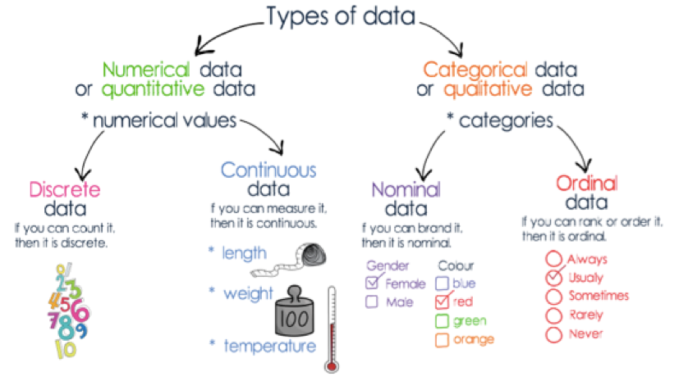
Machine learning

Slide 14
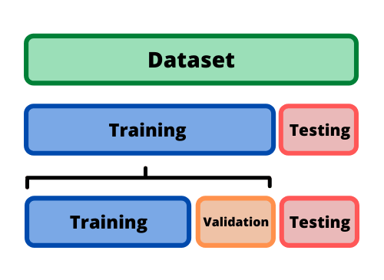
Machine learning
Train and Test Data

Slide 15
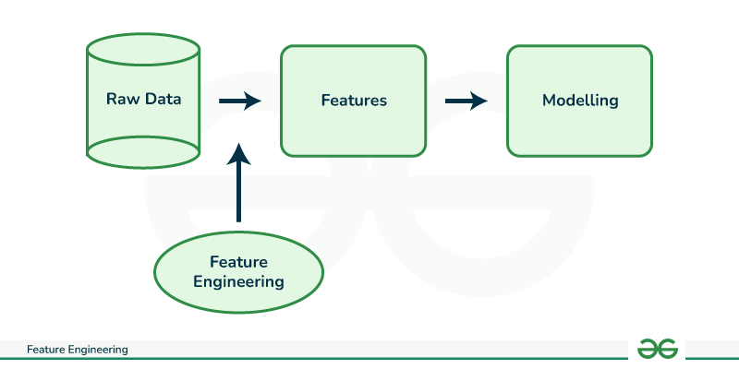
Machine learning
Feature Engineering

Slide 16
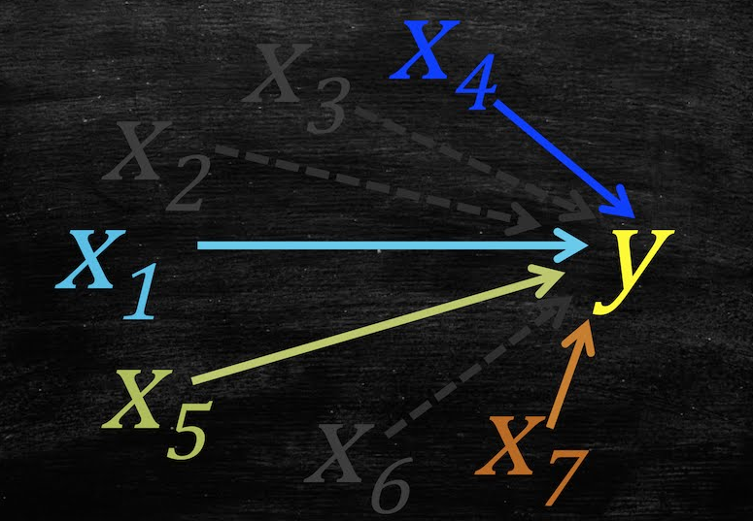
Machine learning
Feature Selection

Slide 17
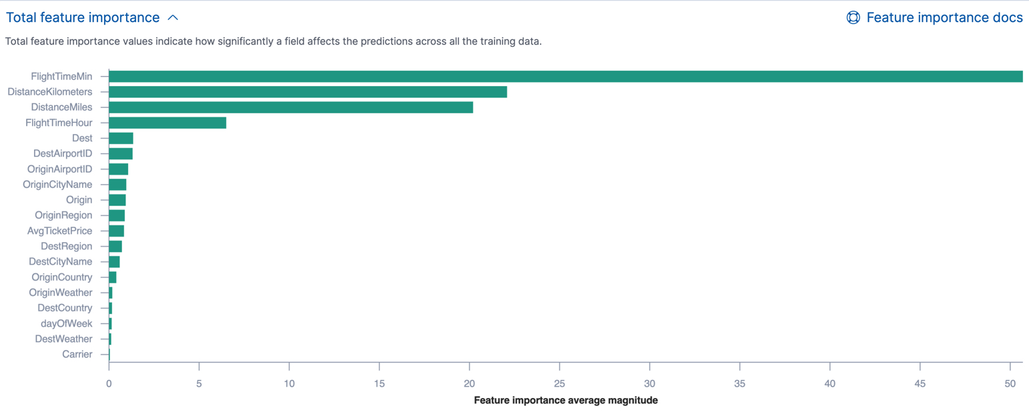
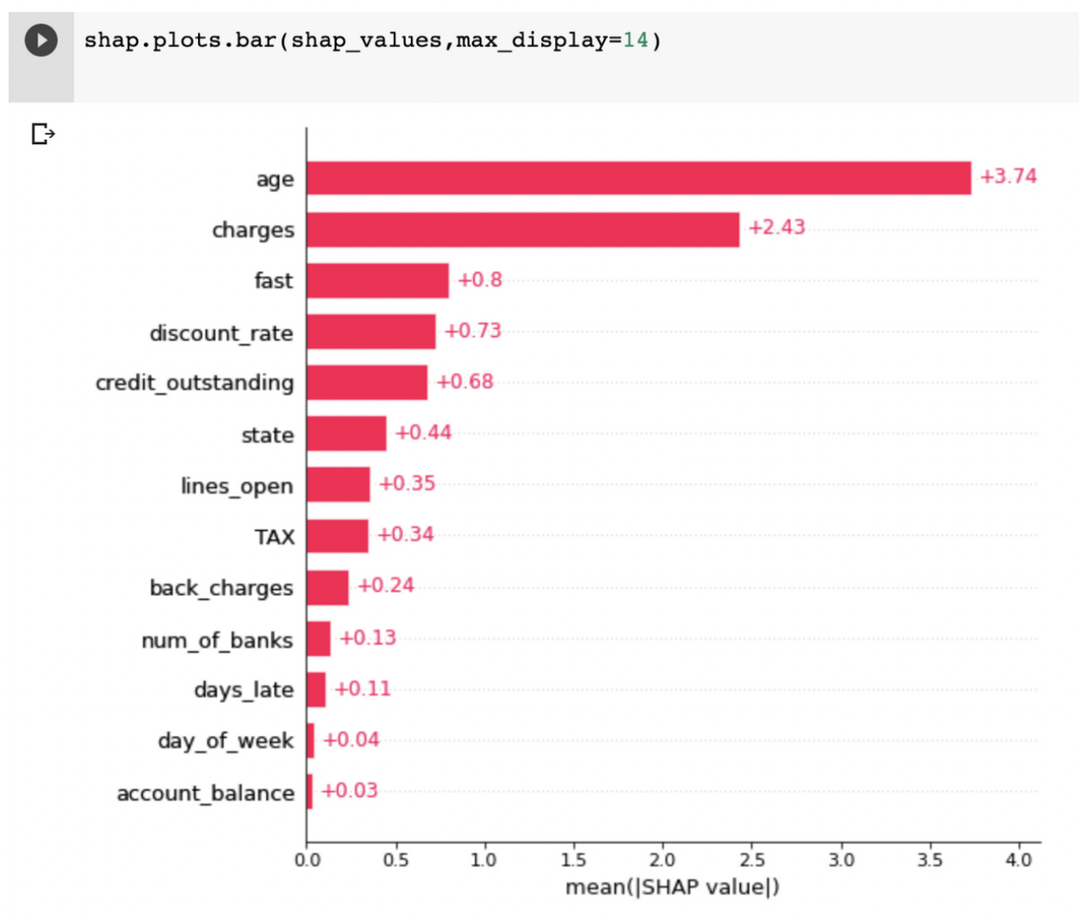
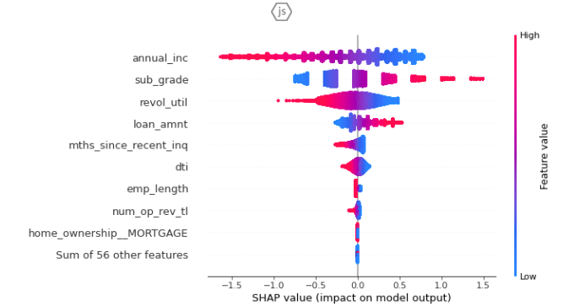
Machine learning
Feature Importance

Slide 18
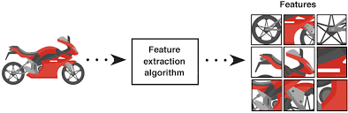
Machine learning
Feature Extraction

Slide 19
Machine learning
Model Selection
Modelin kendi içinde en iyisinin Seçilmesi
Farklı Modellerden en iyisinin seçilmesi

Slide 20
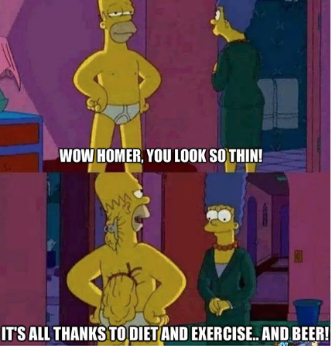

Machine learning
Ovefitting and Underfitting

Slide 21
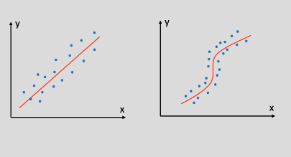
Machine learning
Doğrusal ve Doğrusal Olmayan Modeller

Slide 22

Machine learning
CrossValidation Teknik

Slide 23
Machine learning
Performans Evaluation Metrics

Slide 24
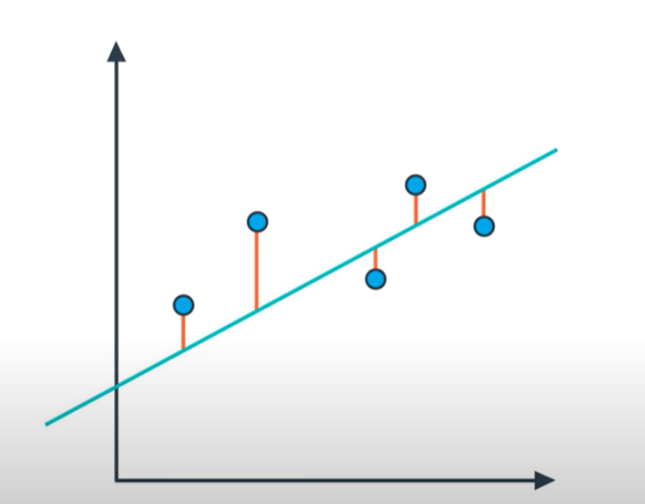
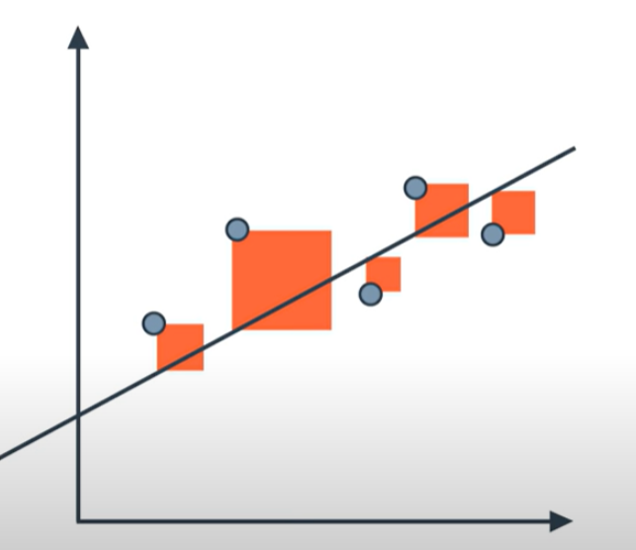
Machine learning
Regression Metrics - Mean Absolute Error
Regression Metrics - Mean Square Error

Slide 25
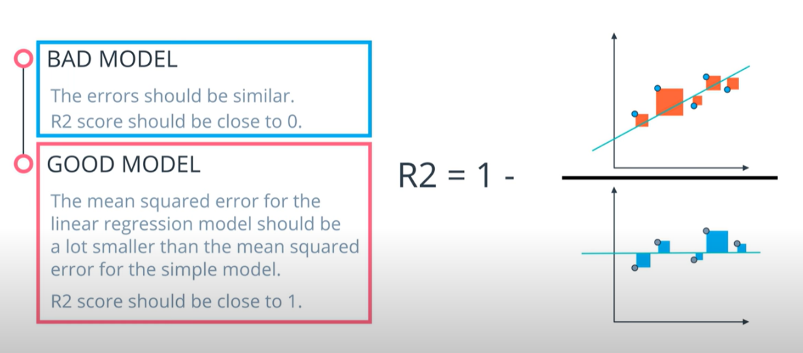
Machine learning
Regression Metrics - R2 Score

Slide 26
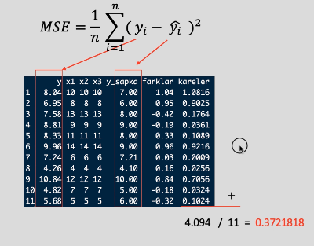
Machine learning

Slide 27
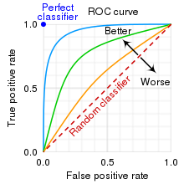
Machine learning
AUC (Area Under The Curve)
ROC (Receiver Operating Characteristics)

Slide 28
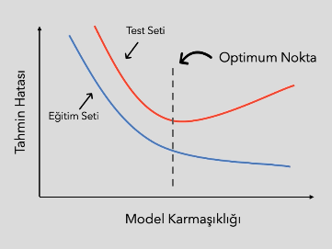
Machine learning

Slide 29
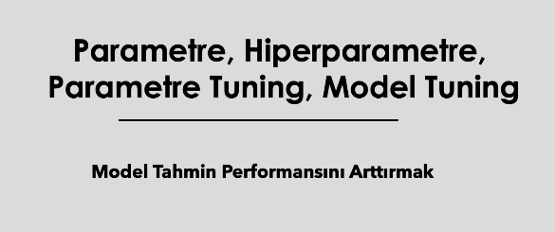
Machine learning

Slide 30
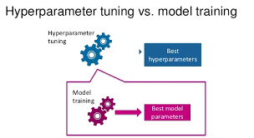
Machine learning

Slide 31
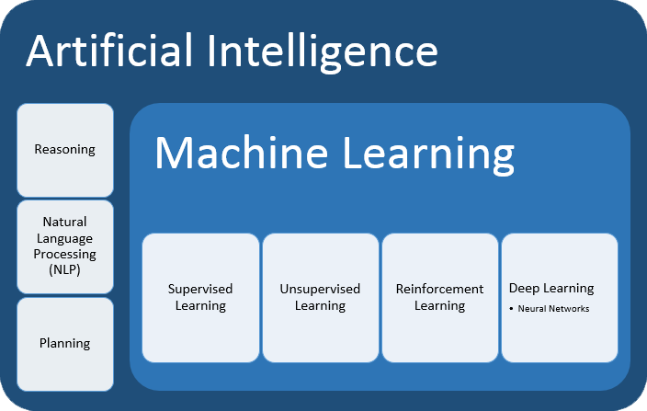
Machine learning

Slide 32
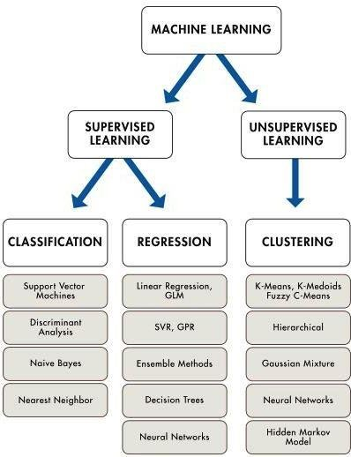
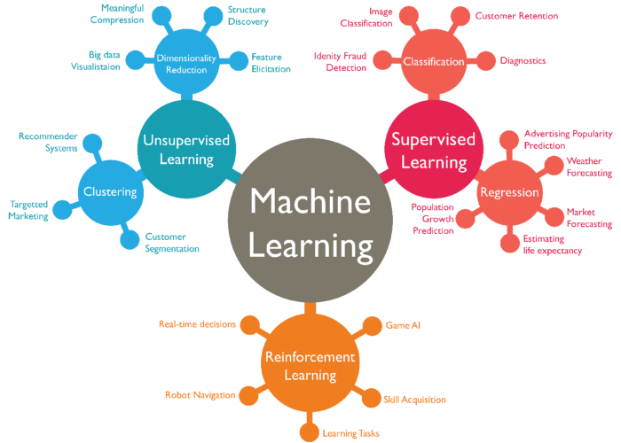
Machine learning

Slide 33
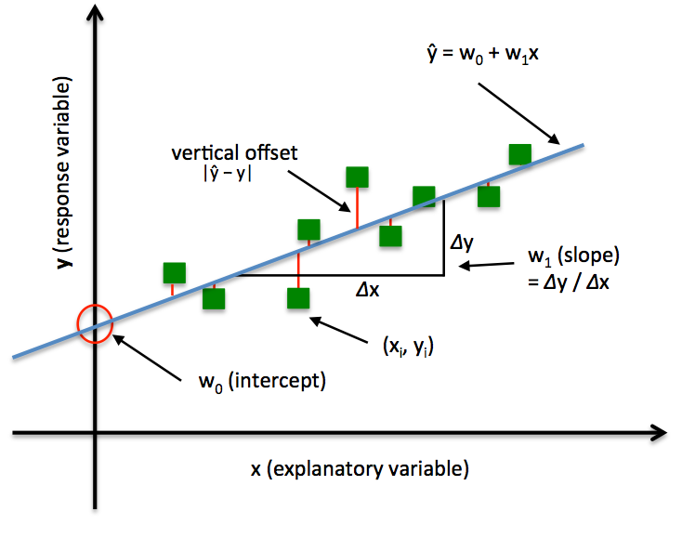
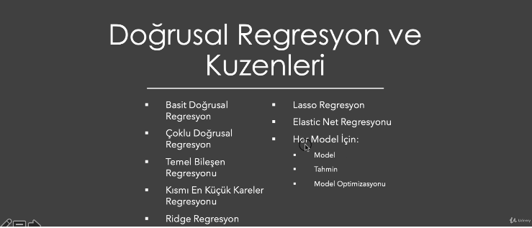
Machine learning

Slide 34
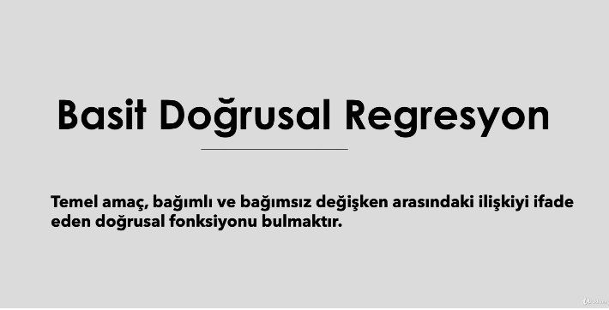
Machine learning

Slide 35
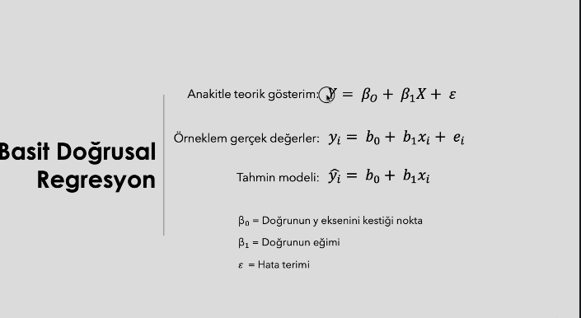
Machine learning

Slide 36
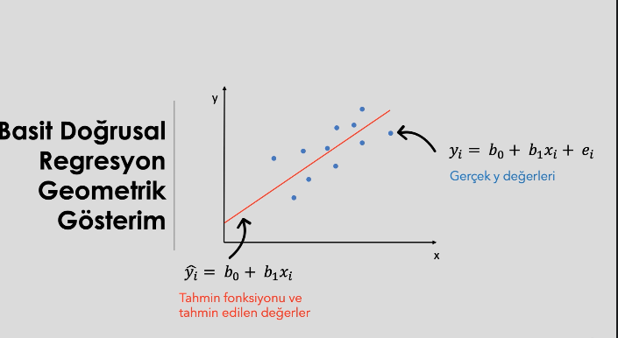
Machine learning

Slide 37
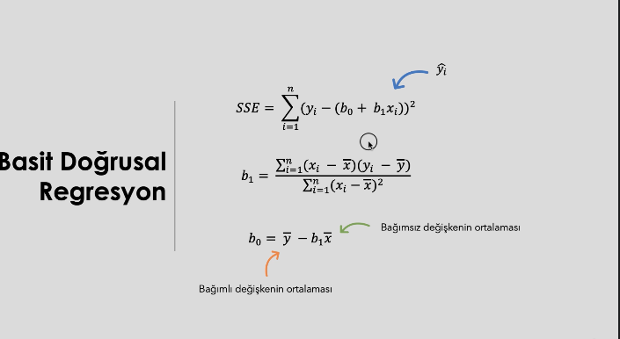
Machine learning

Slide 38
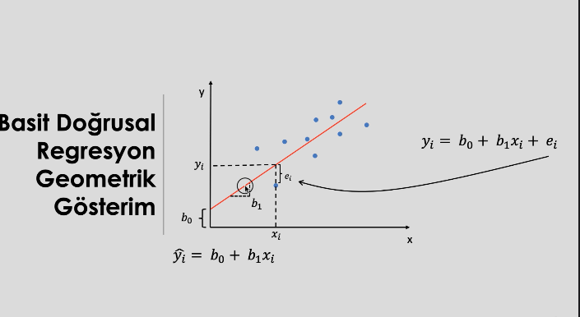
Machine learning

Slide 39
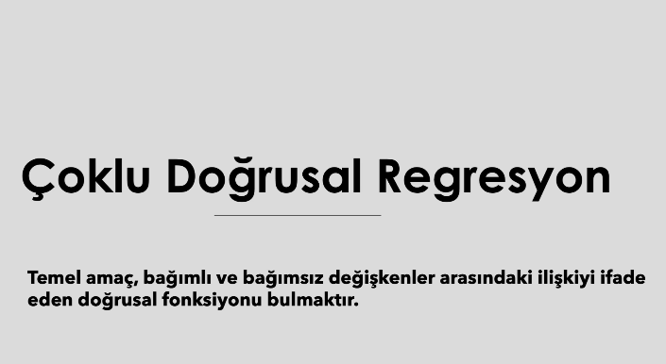
Machine learning

Slide 40
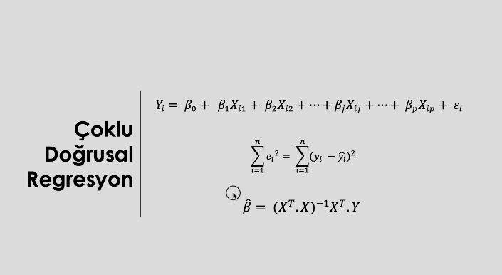
Machine learning

Slide 41
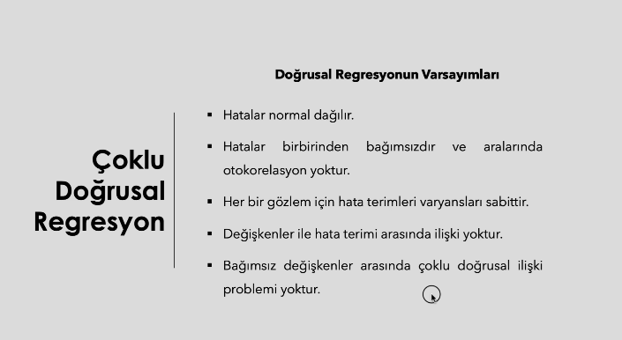
Machine learning

Slide 42
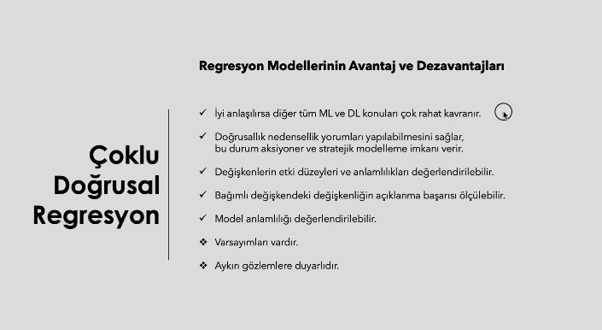
Machine learning

Slide 43


Machine learning

Slide 44

Machine learning

Slide 45

Machine learning

Slide 46

Machine learning

Slide 47

Machine learning

Slide 48

Machine learning

Slide 49

Machine learning

Slide 50

Machine learning

Slide 51

Machine learning

Slide 52

Machine learning

Slide 53

Machine learning

Slide 54

Machine learning

Slide 55

Machine learning

Slide 56

Machine learning

Slide 57

Machine learning

Slide 58

Machine learning

Slide 59

Machine learning

